Slide 1
HOTEL RESERVATION SYSTEM
PRESENTED BY: EMAN WAHEED
FATIMA SABIR LAIBA RANI SANIA SHAFIQUE SANIA ARSHAD

Slide 2
WHAT IS HOTEL RESERVATION SYSTEM?
A hotel reservation system is a software application that allows guests to book directly with the hotel online, with no intermediaries necessary. The software essentially processes online reservations made via the hotel’s website and then passes this information to the hotel’s own backend so that the information can be easily accessed.
Increase efficiency. By automating tasks like rate shopping, inventory management, and email confirmations, an integrated hotel reservation system reduces labor costs, prevents costly errors, and frees up staff to handle more complex tasks. Save on travel agents’ commissions.

Slide 3
SOURCE CODE:
#include <stdio.h>
#include <stdbool.h>
#include <stdlib.h>
#define numRooms 50
bool rooms[numRooms] = { false };
int countAvailableRooms() {
int count = 0;
for (int i = 0; i < numRooms; ++i) {
if (!rooms[i]) {
count++;
}
} return count;
}
void displayMenu() {
printf("\nHotel Reservation System\n”);

Slide 4
printf("1. Book a room\n");
printf("2. Check room availability\n");
printf("3. Display booked rooms\n");
printf("4. Cancel reservation\n");
printf("5. Display available rooms\n");
printf("6. Display room counts\n");
printf("7. Display room details\n");
printf("8. Modify reservation\n");
printf("9. Generate reservation report\n");
printf("10. Exit\n");
}
void bookRoom() {
int roomNumber;
printf("Enter room number to book: ");
scanf_s("%d", &roomNumber);
if (roomNumber >= 1 && roomNumber <= numRooms) {
if (rooms[roomNumber - 1]) {
printf("Room already booked. Try another room.\n");
}
else {
rooms[roomNumber - 1] = true;

Slide 5
printf("Room %d booked successfully.\n", roomNumber);
}
}
else {
printf("Invalid room number. Please enter a number between 1 and %d.\n", numRooms);
}
}
void cancelReservation() {
int roomNumber;
printf("Enter room number to cancel reservation: ");
scanf_s("%d", &roomNumber);
if (roomNumber >= 1 && roomNumber <= numRooms) {
if (rooms[roomNumber - 1]) {
rooms[roomNumber - 1] = false;
printf("Reservation for Room %d canceled successfully.\n", roomNumber);
}
else {
printf("No reservation found for Room %d.\n", roomNumber);
}
} else

Slide 6
{
printf("Invalid room number. Please enter a number between 1 and %d.\n", numRooms);
}
}
void displayAvailableRooms() {
printf("\nAvailable Rooms:\n");
for (int i = 0; i < numRooms; ++i) {
if (!rooms[i]) {
printf("Room %2d - Available\n", i + 1);
}
}
printf("\n");
}
void displayRoomCounts() {
int availableRooms = countAvailableRooms();
printf("Total Rooms: %d\n", numRooms);
printf("Available Rooms: %d\n", availableRooms);
printf("\n");}void displayRoomDetails() {
int roomNumber;
printf("Enter room number to display details:”);

Slide 7
scanf_s("%d", &roomNumber);
if (roomNumber >= 1 && roomNumber <= numRooms) {
printf("\nRoom %d Details:\n", roomNumber);
printf("Capacity: 2 persons\n");
printf("services: TV, Wi-Fi, Bathroom\n");
printf("Price per night: $100\n");
}
else {
printf("Invalid room number. Please enter a number between 1 and %d.\n", numRooms);
}
}
void modifyReservation() {
int roomNumber;
printf("Enter room number to modify reservation: ");
scanf_s("%d", &roomNumber);
if (roomNumber >= 1 && roomNumber <= numRooms) {
if (rooms[roomNumber - 1]) {
printf("Reservation for Room %d modified successfully.\n", roomNumber); }
else {

Slide 8
printf("No reservation found for Room %d.\n", roomNumber);
}
}
else {
printf("Invalid room number. Please enter a number between 1 and %d.\n", numRooms);
}
}
void generateReservationReport() {
printf("\nReservation Report:\n");
for (int i = 0; i < numRooms; ++i) {
if (rooms[i]) {
printf("Room %2d - Reserved\n", i + 1);
}
}
printf("\n");
}
int main() {
int choice;
do {
displayMenu();
printf("Enter your choice: ");

Slide 9
scanf_s("%d", &choice);
switch (choice) {
case 1:
bookRoom();
break;
case 2:
displayAvailableRooms();
break;
case 3:
displayRoomCounts();
break;
case 4:
cancelReservation();
break;
case 5:
displayAvailableRooms();
break;
case 6:
displayRoomCounts();
break;
case 7:

Slide 10
displayRoomDetails();
break;
case 8:
modifyReservation();
break;
case 9:
generateReservationReport();
break;
case 10:
printf("Exiting the program.\n");
break;
default:
printf("Invalid choice. Please enter a valid option.\n");
}
}
while (choice != 10);
return 0;
}

Slide 11
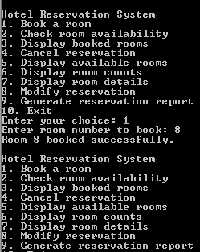
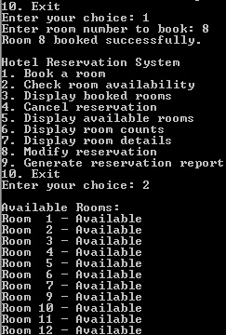
OUTPUT:

Slide 12
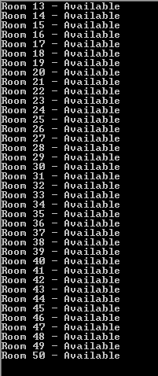
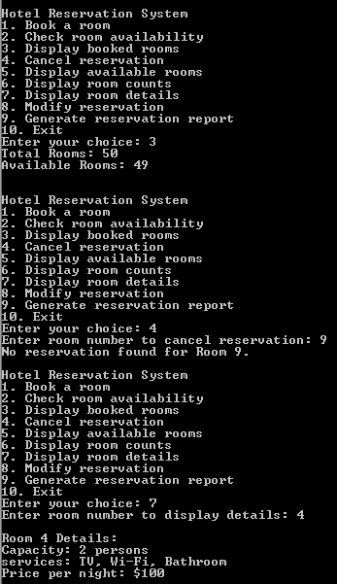

Slide 13
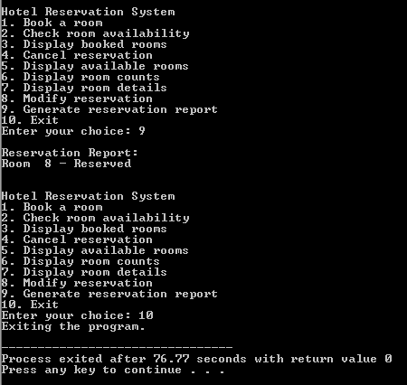

Slide 14
DIFFERENT CONCEPTS:
ARRAYS:
An array is a data structure that contains a group of elements. Typically these elements are all of the same data type, such as an integer or string. Arrays are commonly used in computer programs to organize data so that a related set of values can be easily sorted or searched.
bool rooms[numRooms] = { false };
LOOPS:
A loop in a computer program is an instruction that repeats until a specified condition is reached. In a loop structure, the loop asks a question. If the answer requires action, it is executed. The same question is asked again and again until no further action is required.
for (int i = 0; i<numRooms; ++i)
CONDITIONAL STATEMENTS:
Conditional Statements in C programming are used to make decisions based on the conditions. Conditional statements execute sequentially when there is no condition around the statements.
if (!rooms[i])

Slide 15
FUNCTIONS:
Functions in C are the basic building blocks of a C program. A function is a set of statements enclosed within curly brackets ( {}) that take inputs, do the computation, and provide the resultant output. You can call a function multiple times, thereby allowing reusability and modularity in C programming.
void bookRoom()
SWITCH STATEMENTS: The switch statement is used to perform different actions based on different conditions. Use the switch statement to select one of many code blocks to be executed. The switch expression is evaluated once. The value of the expression is compared with the values of each case. If there is a match, the associated block of code is executed.
switch (choice) {
case 1:
bookRoom();
break;
case 2:
displayAvailableRooms();
break;

